Slide 1
HATE SPEECH DETECTION IN SOCIAL MEDIA
B. Tech Project
Prepared by:
Adhyan
2017BCS0003

Slide 2
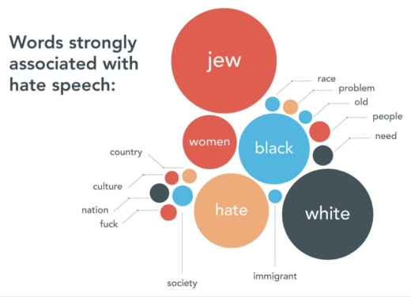
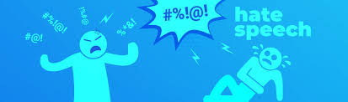
INTRODUCTION
Hate crimes are unfortunately nothing new in society. However, social media and other means of online communication have begun playing a larger role in hate crimes.
Instances – Live Broadcast of attack on Facebook.
Role of social media and its misuse

Slide 3
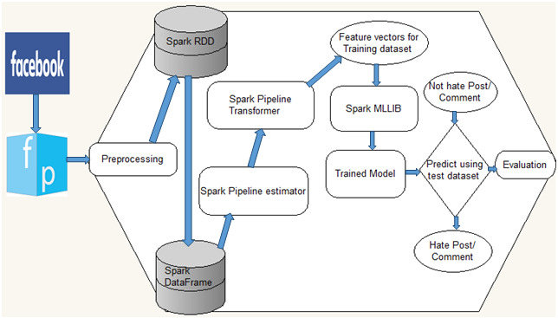
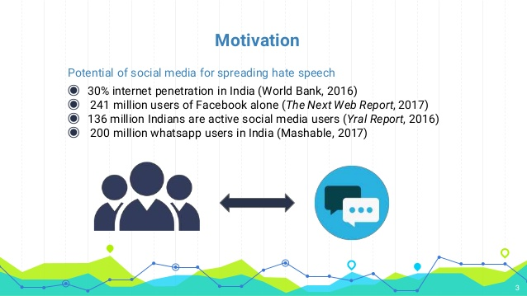
OBJECTIVE
Defining Hate Speech
Hate speech detection

Slide 4
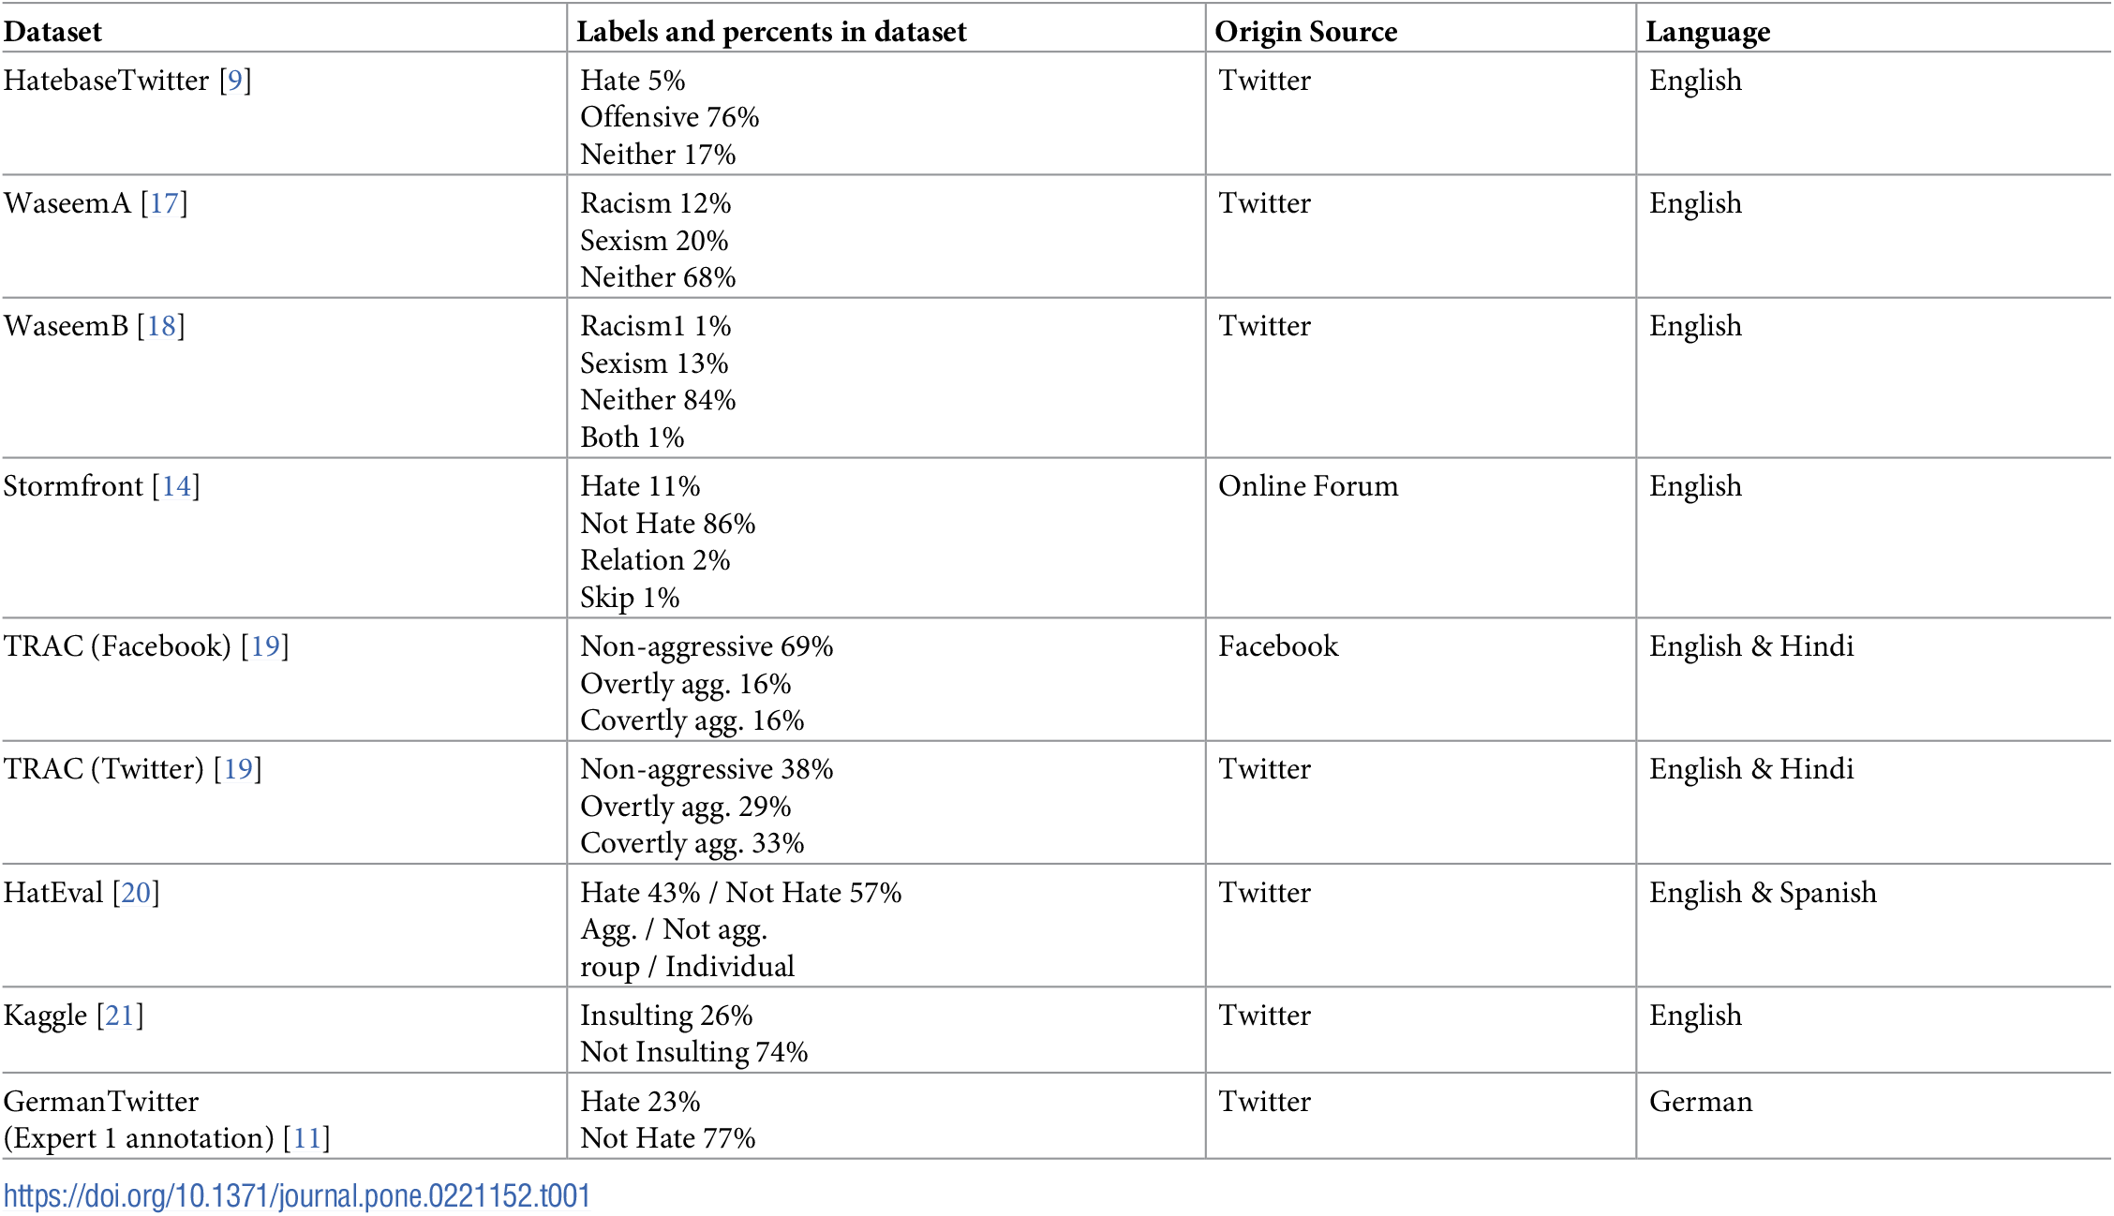
DATASETS
HateBase Twitter
Waseem
TRAC
HatEval
Kaggle
German Twitter

Slide 5
RELATED WORKS
Automatic Approaches
Keyword based approach
Source Annotations
Machine Learning Classifiers
Other approaches and baselines
Naïve Bayes, SVM and Logistic Regression
Davidson, et al.
Neural ensemble
FastText
BERT
CGRU

Slide 6
PROPOSED METHOD
Proposed classifier: Multi-View SVM
It applies a multiple-view stacked Support Vector Machine (mSVM)
Each type of feature (e.g., a word TF-IDF unigram) is fitted with an individual Linear SVM classifier (inverse regularization constant C = 0.1), creating a view-classifier for those features. I will further combine the view classifiers with another Linear SVM (C = 0.1) to produce a meta-classifier.
The features used in the meta-classifier are the predicted probability of each label by each view-classifier
This model offers the opportunity to interpret the model so as to identify which view-classifier contributes most through the meta-classifier provides human intuition for the classification. The view-classifier contributing most to the final decision identifies key vocabulary (features) resulting in a hate speech label. This contrasts with well-performing neural models, which are often opaque and difficult to understand.

Slide 7
WORKFLOW
PHASE 1
DATA COLLECTION
DATA CLEANING AND PREPROCESSING
COMPARE VARIOUS PREDEFINED MODELS
PHASE 2
FEATURE EXTRACTION
USING OWN DICTIONARY AND STOPWORDS
NGRAMIZATION USING CHI SQUARE TEST
PHASE 3
FEED NEW FEATURES TO MODEL WITH TUNED HYPERPARMAETERS
COMPARE PERFORMANCE WITH ALREADY EXISTING WORKS

Slide 8
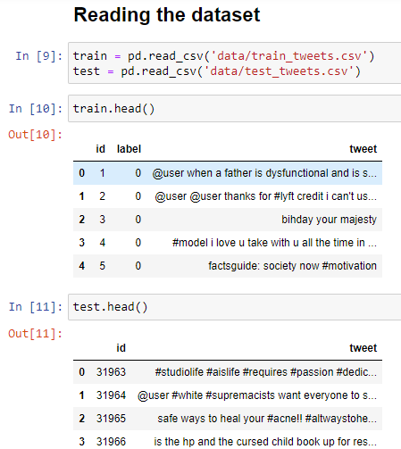
PHASE 1 IMPLEMENTATION
Until now, I have trained “HateBase Twitter” dataset on various models which I will show here. I will provide an explanation of the code.

Slide 9
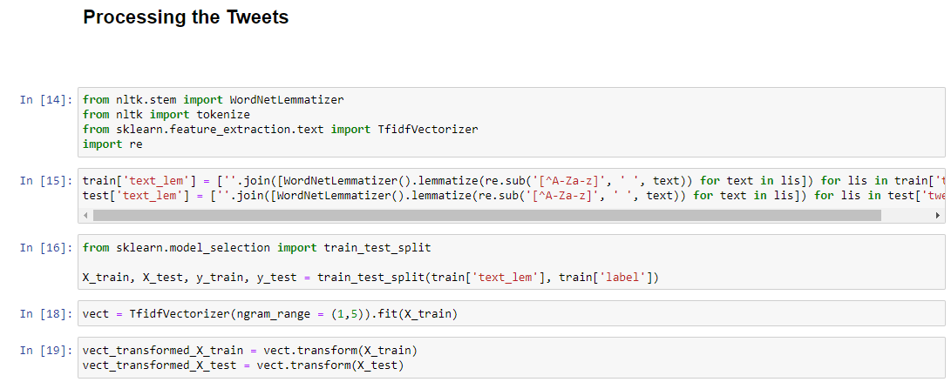
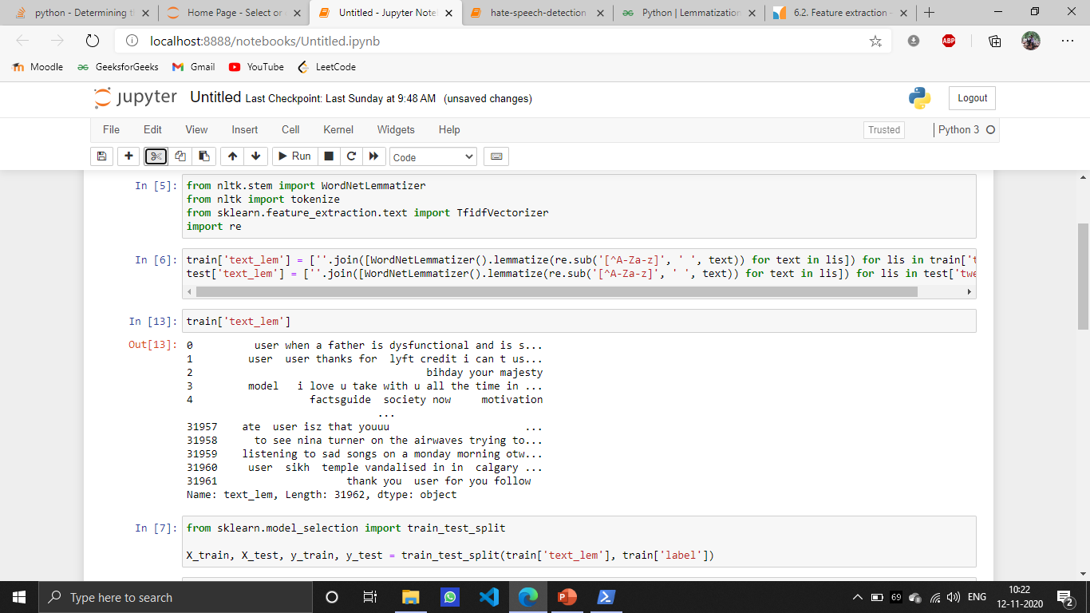
LEMMATIZATION

Slide 10
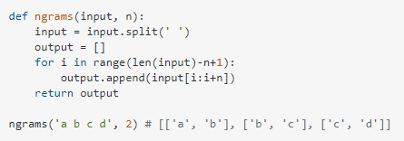
What does it mean to Ngramize?

Slide 11
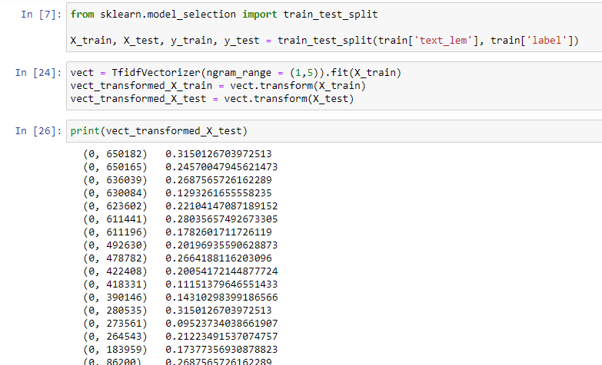
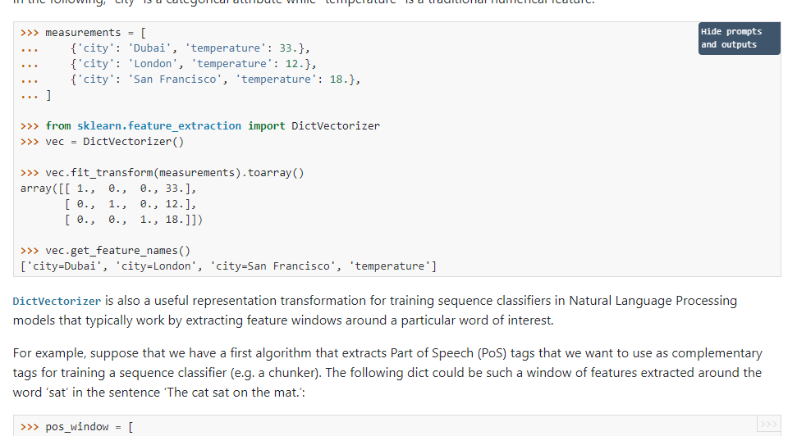
TF-IDF Vectorization

Slide 12
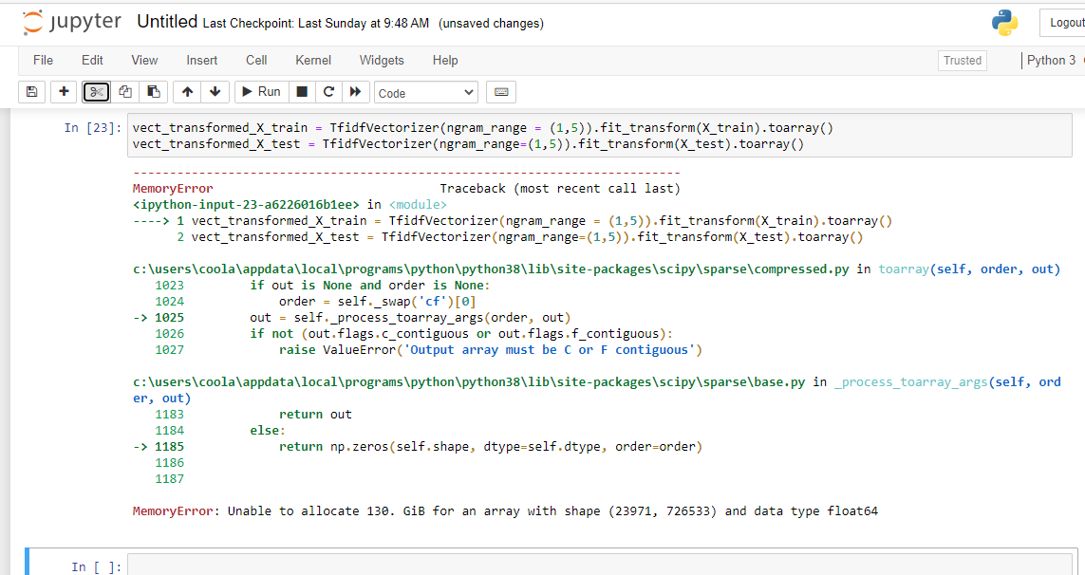
TF-IDF Vectorization

Slide 13
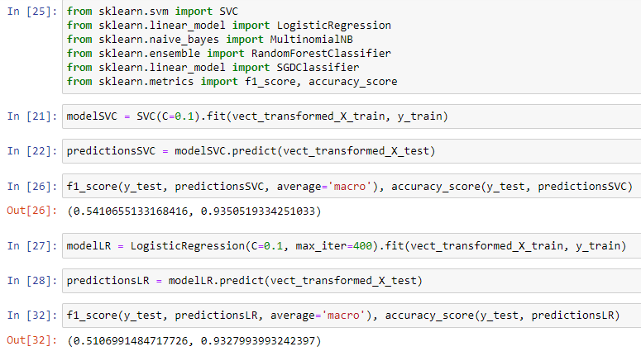
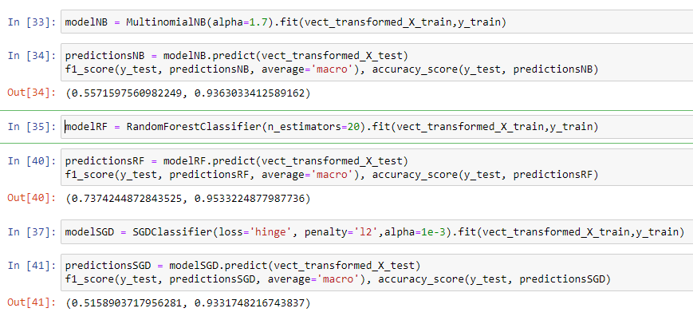
RESULTS OBTAINED
After this, I trained various models that are already available and following are the results obtained

Slide 14
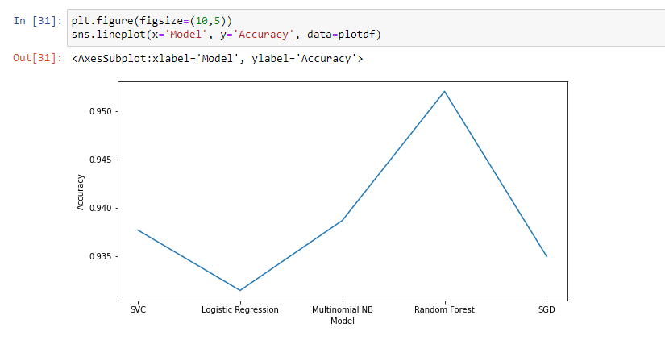
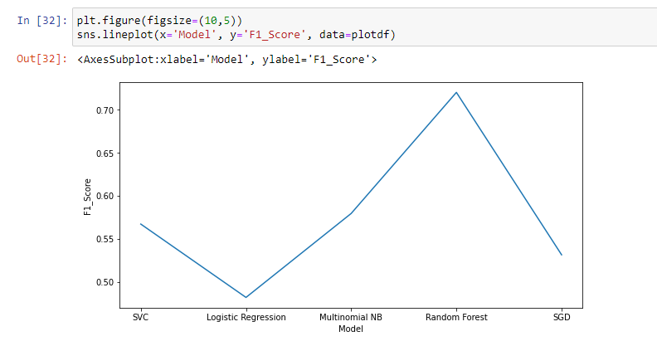
RESULTS

Slide 15
PHASE 1 COMPLETED PHASE 2 STARTS

Slide 16
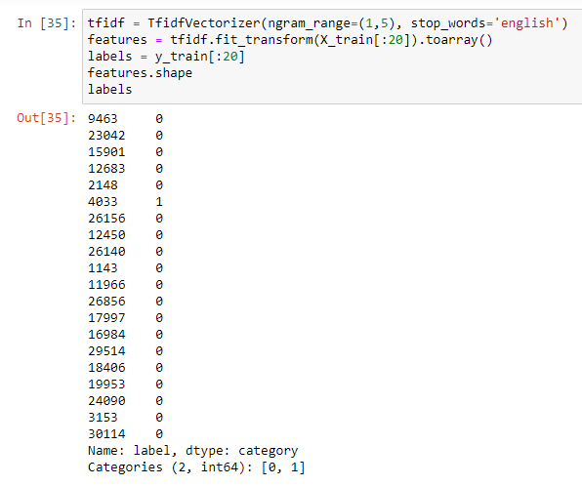
SOME MORE PREPROCESSING
Removing stop-words and correcting the stylized words using my own dictionary.

Slide 17
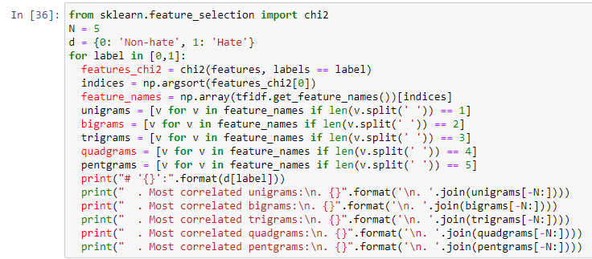
Using Chi-Square Test for Feature Selection
A chi-square test is used in statistics to test the independence of two events.
Here we use this test to find out the dependence the labelled value 0 or 1 on different sets of words (ngrams).
We use ngrams in range(1,5) so that we can see how a word or a group of words can be termed as or contribute to a sentence labelled as hate speech.
Out of all these features, I will take the pentagrams and then move create a different dataset with it to train the model to identify the words or sentences that contribute most towards a hate speech.

Slide 18
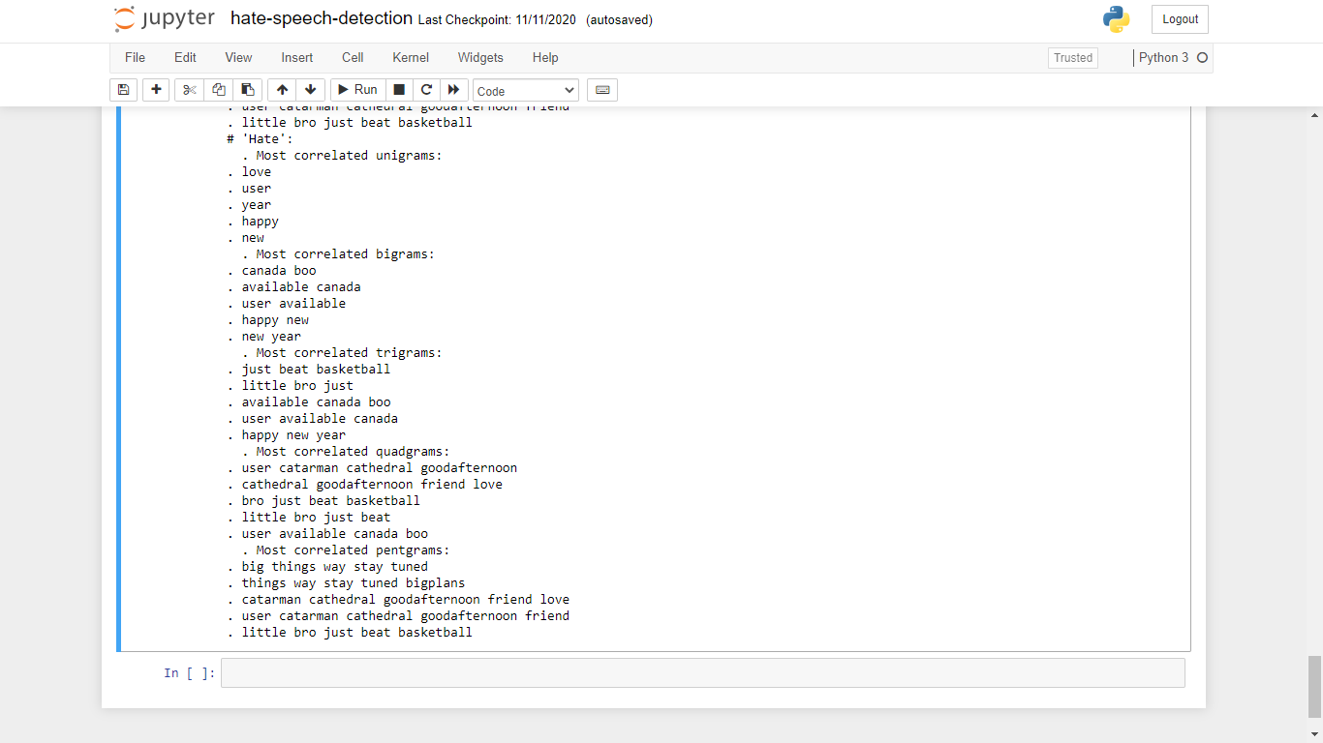
Results of Chi-Square

Slide 19
Work to be done
Phase 2 is complete upto here.
From the results of chi-square test, I will create a dataset using 3,4,5-gram words and feed it to various classifiers to improve their accuracy.
It requires a lot of memory space and will have to be trained on a cloud server.
In the final phase we’ll see how various models perform on this new dataset of ngrams.
We’ll also build our own model with various tuned hyperparameters to improve performance

Slide 20
CONCLUSION
As hate speech continues to be a societal problem, the need for automatic hate speech detection systems becomes more apparent. I presented the current approaches for this task as well as a new system that may achieve a reasonable accuracy. I also propose a new approach that can outperform existing systems at this task, with the added benefit of improved interpretability. Given all the challenges that remain, there is a need for more research on this problem, including both technical and practical matters.

Slide 21
REFERENCES
1.Robertson C, Mele C, Tavernise S. 11 Killed in Synagogue Massacre; Suspect Charged With 29 Counts. 2018;.
2.The New York Times. New Zealand Shooting Live Updates: 49 Are Dead After 2 Mosques Are Hit. 2019;.
3.Hate Speech—ABA Legal Fact Check—American Bar Association;. Available from: https://abalegalfactcheck.com/articles/hate-speech.html.
4.Community Standards;. Available from: https://www.facebook.com/communitystandards/objectionable_content.
5.Hate speech policy—YouTube Help;. Available from: https://support.google.com/youtube/answer/2801939.
6.Hateful conduct policy;. Available from: https://help.twitter.com/en/rules-and-policies/hateful-conduct-policy.
7.Mondal M, Silva LA, Benevenuto F. A Measurement Study of Hate Speech in Social Media. In: ACM HyperText; 2017.
8.Fortuna P, Nunes S. A Survey on Automatic Detection of Hate Speech in Text. ACM Comput Surv. 2018;51(4):85:1–85:30
9.Davidson T, Warmsley D, Macy MW, Weber I. Automated Hate Speech Detection and the Problem of Offensive Language. ICWSM. 2017;.
10.Zimmerman S, Kruschwitz U, Fox C. Improving Hate Speech Detection with Deep Learning Ensembles. In: LREC; 2018

Slide 22
THANK YOU

